Slide 1
CROSS CULTURAL FUNDraISING
Joshua Chu

Slide 2
Fundraising is a north American cultural activity

Slide 4
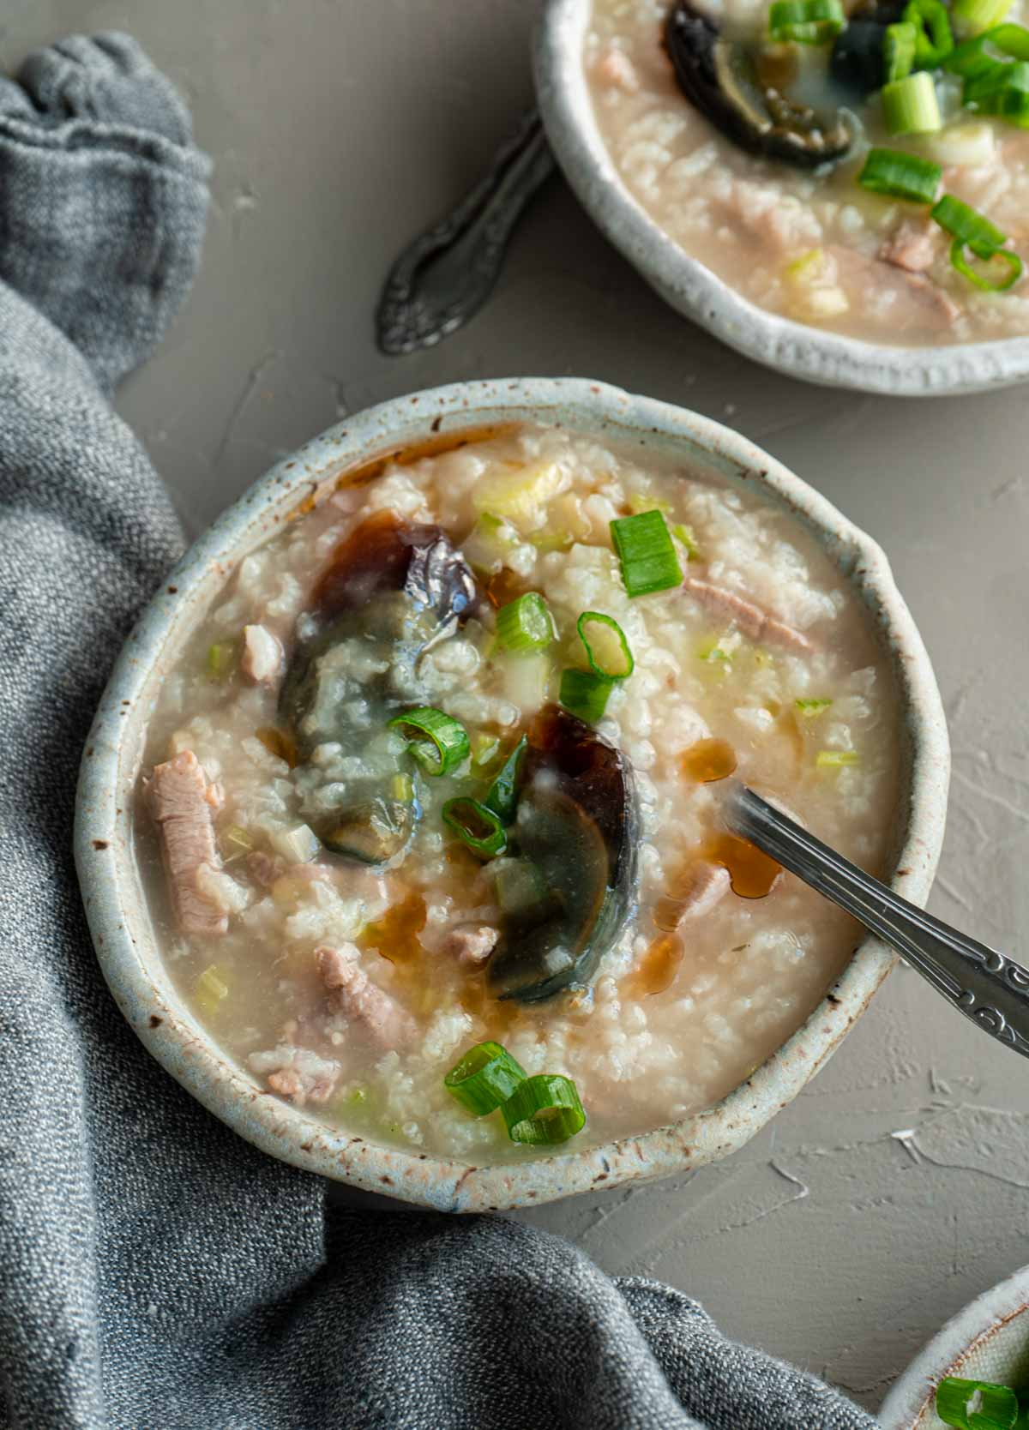
congee

Slide 5
Fundraising is a north American cultural activity
A lack of
culturally familiar onramps

Slide 6
Fundraising is a north American cultural activity
A lack of
culturally familiar onramps
An experience of provision

Slide 7
Make your message culturally compelling
Make your method
culturally comfortable
Invest in a
culturally diverse membership

Slide 9
LAST REMARKS

